Slide 1
Dementia Caregiving Basics
Susan Johnson, MS
Dementia Care Specialist
Kenosha County Aging and Disability Resource Center

Slide 2
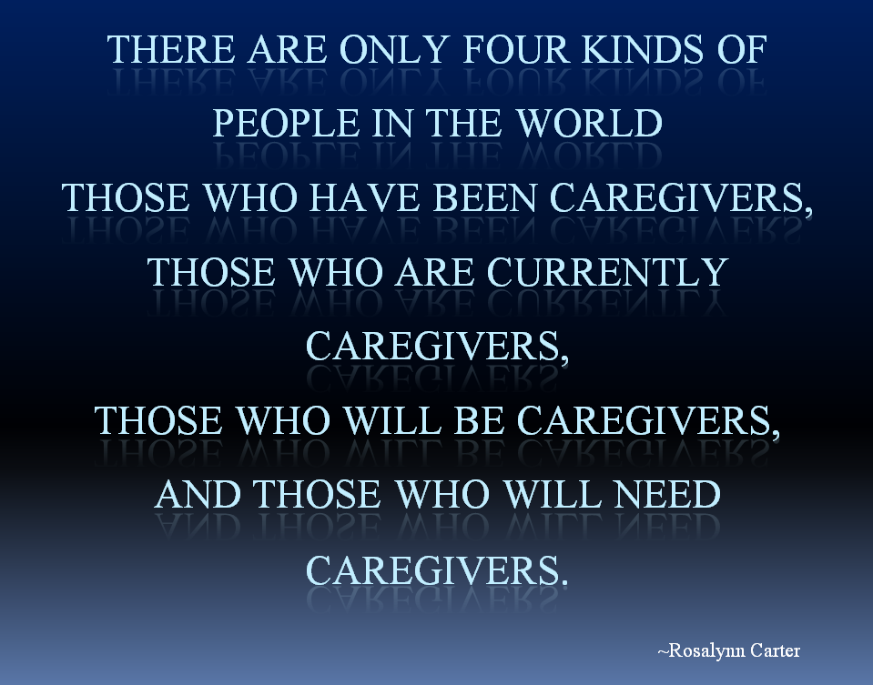
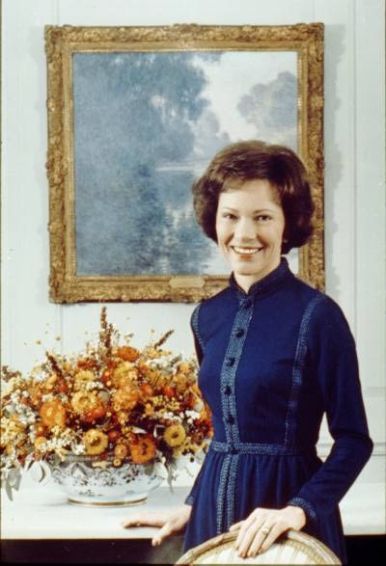

Slide 3
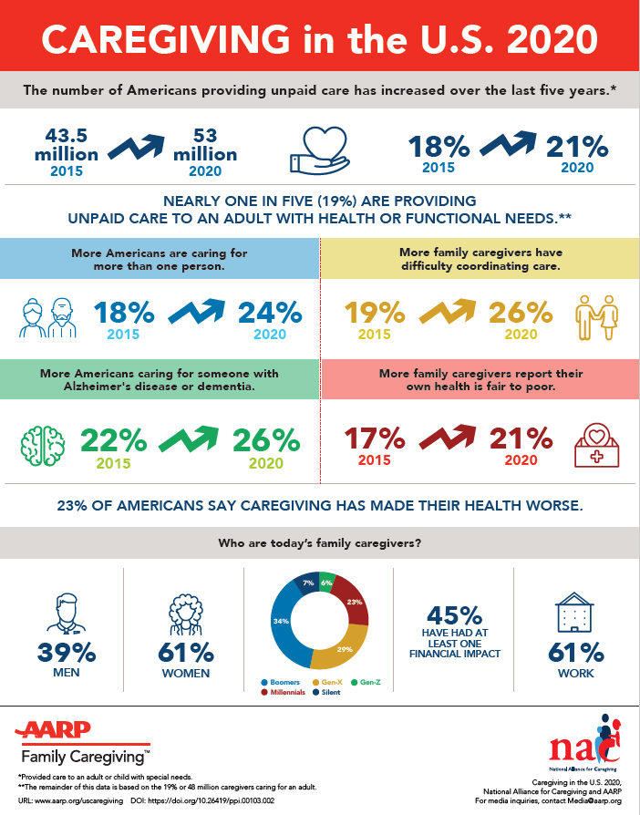

Slide 4

Self Identification
Why don’t more caregivers identify themselves as such?

Slide 5


Are You A Caregiver?
DO YOU………..
Remind them to take their medication and vitamins?
Make a call to them to make sure they’re doing ok?
Make them laugh when they’re feeling blue?
Are you a grandparent raising a grandchild?
Take them to their doctor’s appointment?
Help a loved one with lawn work?
Drive them to the grocery store?
Help them organize or pay bills?
Pick up their prescriptions?
Monitor their eating habits?
Balance their checkbook?
Assist with their laundry
Shovel their sidewalk
Help clean their home
Manage their calendar?
Cook meals for them?
Take them to church?
Clean their glasses?
Clean their gutters?
Do home repairs?
Walk their dog?

Slide 6

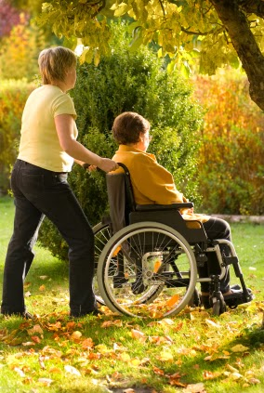
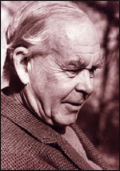
“It’s a Relationship, Not a Role”

Slide 7
Or Are You a Care Partner?

Slide 8

Why is early identification important?
Leads to better use of resources
Helps caregiver maintain positive feelings

Slide 9

THE BASICS
Obtain a Diagnosis
Prepare for the
Future
Educate Yourself
Take Care of You
Build Your Care Team
  Create a Back-up Plan

Slide 10

Daniel Kuhn
“…seeks to replace fear with knowledge, in the hope that knowledge will lead to empowerment.”

Slide 11

The Diagnosis

Slide 12
DIAGNOSIS
Complete medical exam
Neurology exam
Neuropsychological testing
Wisconsin Alzheimer’s Institute affiliated clinics
Latino Geriatric Center Mobile Clinic

Slide 13
What is dementia?
A condition that represents a cognitive decline from a previous level of functioning
A condition that has resulted in brain
cell death affecting more than one area
of cognition (thinking ability)
  memory - language
  attention - abstraction
  reasoning - visual perception
  organization - judgment

Slide 14

DEMENTIA IS…
NOT normal age-related memory loss
NOT a normal outcome of aging

Slide 15
Reversible or treatable causes of memory loss
Adverse medication interactions and
side effects
Untreated infections
or other medical issues – UTI, uncontrolled diabetes or heart disease, dehydration
Frequent lack of sleep and sleep disturbances
Chronic pain
Hypothyroidism
High levels of stress
Depression or anxiety
Chronic alcohol use
Vitamin deficiency or electrolyte imbalance

Slide 16
There are more than 70 dementia-related illnesses.

Slide 17
Dementia
Symptoms vary depending on the type
of dementia
Not everyone exhibits the same symptoms
There is currently no cure for dementia diseases, including Alzheimer’s Disease
Progressive and degenerative

Slide 18
Cognitive continuum
Normal Mild Cognitive Impairment Dementia
Normal = age-related memory changes
  Memory of names for objects/people
  No impairment of daily functioning, not progressive
Mild Cognitive Impairment
  Significant memory impairment (noticeable by family)
  No impairment of daily functioning, but generally progressive
Dementia
  Significant impairment of daily functioning plus progressive memory loss and/or impairment of other areas of cognition

Slide 19
Most common types of dementia
Alzheimer’s Disease – the most frequently occurring dementia, affecting 60-80 % of all people with dementia; memory loss is the hallmark
  Abnormal proteins (beta amyloid and tau)
  LATE (Limbic-predominant Age-related TDP-43 Encephalopathy)
    Seems to be present later in life and progresses more slowly
Vascular Dementia – caused by a single large stroke (CVA), many small strokes (TIA), or micro-strokes that happen over time with cumulative effects

Slide 20
Most common types
Frontotemporal Degeneration – caused by various diseases that affect the frontal and temporal lobes of the brain
  Behavioral variant FTD (bvFTD)
  Primary Progressive aphasia (PPA)
  Corticobasal Syndrome
  Progressive Supranuclear Palsy
Mixed Dementias

Slide 21
Lewy body dementia
An umbrella term
  Dementia with Lewy bodies
    Will develop dementia and other LBD symptoms
  Parkinson’s disease dementia
    Changes in movement first; maybe dementia years later
Requires comprehensive treatment approach
  OT, PT, Speech therapy

Slide 22
Common Symptoms of LBD
Impaired thinking
Fluctuations in cognition, attention, or alertness
Problems with movement
  Tremors, stiffness, slowness, difficulty walking

Slide 23
Common Symptoms of LBD
Visual hallucinations
Sleep disorders
Behavioral and mood symptoms
  Depression, apathy, anxiety, agitation, delusions or
  paranoia
Lewy Body Dementia Association (LBD)
www.lbda.org

Slide 24
Planning for the Future
Health Care Power of Attorney
Financial Power of Attorney
Meeting growing care needs
Include the person living with dementia
  Person-centered care
Focus on strengths, not limitations

Slide 25
Educate Yourself
Learn all you can about the disease
What to expect: changes in function
Develop tools and strategies for managing symptoms
Learn about resources
  Use reputable sources

Slide 26
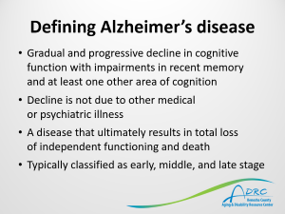
Defining Alzheimer’s disease
Gradual and progressive decline in cognitive function with impairments in recent memory
and at least one other area of cognition
Decline is not due to other medical
or psychiatric illness
A disease that ultimately results in total loss
of independent functioning and death
Typically classified as early, middle, and late stage

Slide 27
Alzheimer’s disease
Early-Stage
  Memory loss is the
  primary symptom
  Difficulty finding words
  and remembering names
  Repetitive words,
  thoughts, questions
  Becoming lost
  in familiar places
Increased irritability
and personality changes
Difficulty completing
familiar tasks

Slide 28
Alzheimer’s disease
Middle-Stage
  Paranoid thinking
  and accusations
  Passive/quiet vs easily frustrated/agitated
  Misplacing or hiding items
  in odd places, hoarding,
  and rummaging
  Anxiety or depression
  Sleep disturbances
  Increased confusion

Slide 29
Alzheimer’s disease
Late-Stage
  Pacing and wandering
  Sensory losses and hallucinations
  Changes in physical abilities, including walking, sitting and eventually, swallowing
  Increasing difficulty communicating
  Vulnerable to infections, especially pneumonia

Slide 30
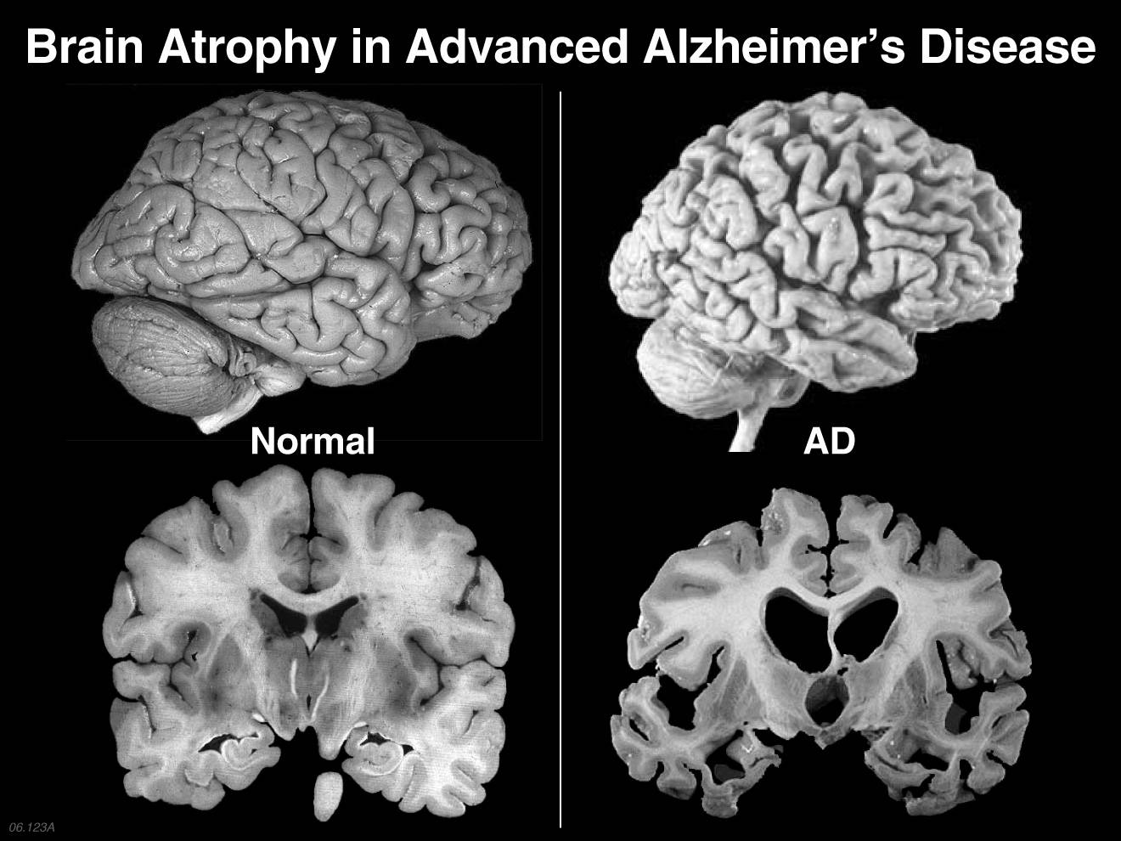

Slide 31
Common Behavioral Symptoms
Repetition
Paranoia and suspicion
Agitation
Anxiety
Resistance
Hoarding
Wandering
Sleep problems

Slide 32
Managing Behavioral Symptoms
Behavior is a form of communication
Expect behavioral expressions
  Know that you can learn strategies to manage them.
Be a behavior detective.
  Learn to identify the triggers
  Be aware of sudden changes

Slide 33
Change Our Focus
Look for the emotion behind the words
or behavior
Make what is important to them important to us – even if it doesn’t make sense
Make it our goal to provide comfort
(vs. being right)
Create moments of joy and laughter
wherever we can find it

Slide 34
We need to change because they cannot
Not helpful:
Insist on remembering: “of course you remember…!”
Scold, judge, or demean: “I just told you…,” Why do you always…,” “Stop asking…”
Argue with or correct the person
Insist they live in the present – your reality

Slide 35
Helpful
Speak slowly, clearly, calmly, and only
as loudly as needed
Speak face to face, at eye level - Sit next to, if sitting, stand next to, if standing
Be positive and upbeat, but genuine
Give extra time for them to process and respond before repeating – count to 10

Slide 36
Helpful
Be aware of your body language
and facial expression
A soothing tone of voice can be
more important than the words
Keep directions and questions short
– one step or question at a time
Use your “super power”

Slide 37
General Caregiving Tips
Importance of routine
Realistic goals
  Lessening the negative impact of the behavior
Adapt to changes in functioning
Practice Compassionate Communication
Know there will be good and bad days
Behavior management strategies are key*

Slide 38
General Caregiving Tips
If meds are needed, start low, go slow – one at a time
Be aware of the meaning of abrupt and sudden changes in cognition and function
Promote your own health and well-being
SCSF Memory & Aging Center
Jennifer Merrilees, RN, PhD, Mary De May, MD

Slide 39
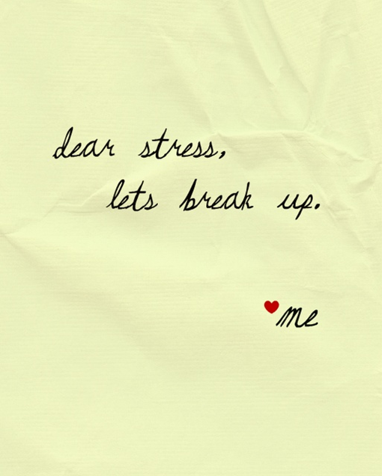
What do Caregivers say they need?
Greatest needs
  Finding time for oneself
  Managing emotional
    and physical stress
  Balancing work and family responsibilities

Slide 40
Signs of Caregiver Stress
Feeling overwhelmed or constantly worried
Feeling tired often
Getting too much sleep or not enough sleep
Gaining or losing weight
Becoming easily irritated or angry

Slide 41
Signs of Caregiver Stress
Losing interest in activities you used to enjoy
Feeling sad
Having frequent headaches, bodily pain or other physical problems
Abusing alcohol or drugs, including prescription medications

Slide 42

Managing Stress
Accept help.
Focus on what you are able to provide.
Set realistic goals.
Get connected.
Join a support group.
Seek social support.
Set personal health goals.
See your doctor.

Slide 43

Seek Support
Family and friends
Support Groups
Professional counseling

Slide 44

Schedule Respite
Schedule respite time
Ask for what you need
“Feather your nest”
Make a list
Caregiver grants

Slide 45
Building Your Care Team
Family
Medical personnel
Friends
Technology
Community Resources
Be a “Care Manager”

Slide 46
Create a Back-Up Plan
Who will take over, if you become ill?
Do “they” know this?
File of Life
Complete Care Plan Form
  Maybe have a binder with the information.

Slide 47
Community Resources
Kenosha County Aging and Disability Resource Center
8600 Sheridan Road
262-605-6646
  Information and assistance
  Loan closet
  Benefits Specialists

Slide 48
Kenosha County ADRC
  Caregiver grants
  Powerful Tools for Caregivers
  Health Care Power of Attorney
  Transportation
    Mobility Manager

Slide 49
Dementia Care Assistance
Dementia Care Specialist – Susan Johnson
262-605-6602
susan.johnson@kenoshacounty.org
    One-on-one consultations
    Family meetings
    Educational classes and programs
    Music and Memory
    DICE – Behavioral symptom management
    Memory Café - virtual
    The Savvy Caregiver class

Slide 50
Community Resources
Kenosha Area Family and Aging Services, Inc.
  (KAFASI)
  -Meals on Wheels
-Friendly Visitor Program
-Senior Center Without Walls
Supportive In-Home Care Services
Adult Day Programs
SPARK!

Slide 51

Community Resources
Virtual Support Groups
AlzConnected (www.alz.org)
Family Caregiver Alliance
  https://www.caregiver.org/fact-sheets
Specific disease sites

Slide 52

  Online education programs
  Online Support Groups
  Care Consultations
  24/7 Helpline
1-800-272-3900

Slide 53

Positive aspects of caregiving
Makes caregiver feel good about themselves
Caregivers feel needed
Caregiving gives meaning to their lives
Enables them to learn new skills
Strengthens relationships with others

Slide 54
Susan L. –J. Dickinson, MS, CGC
Executive Director
The Association for Frontotemporal Degeneration
“The tragedy of this disease is the loved one you are losing. The great hope is that you do not need to let FTD ruin the other things you value most in your life. The information in this book will provide you with the tools to know three critical things for the journey ahead: You are not alone.

Slide 55
You are not helpless. And you need not cede all control to the disease. Use these tools as a source of strength to face the challenges ahead of you, and you will be honoring the person you are losing in the greatest way possible.”
What If It’s Not Alzheimer’s: A Caregiver’s Guide to Dementia?
Edited by Lisa Radin and Gary Radin

Slide 56
Key Messages
“The great hope is that you do not need to let FTD (dementia) ruin the other things you value most in your life.”
“You are not helpless.”
“You need not cede all control to the disease.”

Slide 57

“Putting Illness In Its Place”

Slide 58
QUESTIONS?

