Slide 1
Top Tips for Maximizing Treatment and Quality of Life in Vascular Dementia,Lewy-Body Dementia, and Frontotemporal Dementia
Michelle Braun, PhD, ABPP-CN
Board-Certified Neuropsychologist

Slide 2
Overview
Dementia subtype is defined by the TYPE of cellular abnormality and the LOCATION of the abnormality
Cellular abnormalities may or may NOT lead to symptoms (if symptoms occur, the type of symptom is usually related to the type of cellular abnormality and location)
Alzheimer’s is the most common type of dementia
Vascular dementia, Lewy-Body dementia, and Frontotemporal dementia are the next most common subtypes
More than 50% of dementias are “mixed” (have more than one type of cellular abnormality)
120,000 people in WI have dementia (expected to increase to 130,000 by 2025); 194,000 caregivers in WI

Slide 3
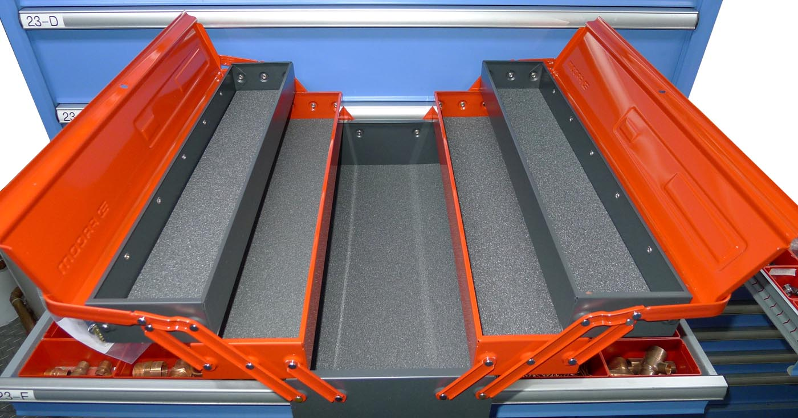
“Top Tips” Toolbox
FTD
Tools
LBD
Tools
VD
Tools
General
Tools

Slide 4
GENERAL TOOLS to enhance mood and minimize distress in most dementias
All can be helpful proactively and reactively
Routine
Distraction
Not correcting mis-remembered information (striving for harmony vs. factual accuracy)
Tailored calming strategies
Music, family time, reading, praying, television, pictures – customization is key
Tactile tools (touch, aromatherapy, objects, music, pets, walking, games)

Slide 5
Vascular Dementia

Slide 6
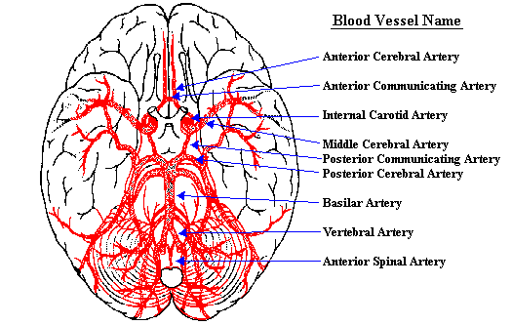
Blood provides oxygen and nutrients to the brain
BLOOD SUPPLY
Every time your heart beats, about 25% of the blood goes to your brain!
Blood flow through whole brain (adult) = 750-1000 ml/min
Blood flow is fundamental to good brain functioning (http://pathology.mc.duke.edu/neuropath/nawr/blood-supply.html)
http://faculty.washington.edu/chudler/facts.html
Notes:
Brain is only 2% of body weight
Many cognitive px caused by issues w/blood flow

Slide 7
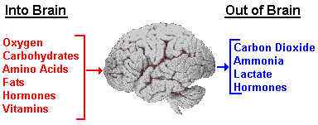
What enters and leaves the brain?
http://faculty.washington.edu/chudler/vessel.html

Slide 8
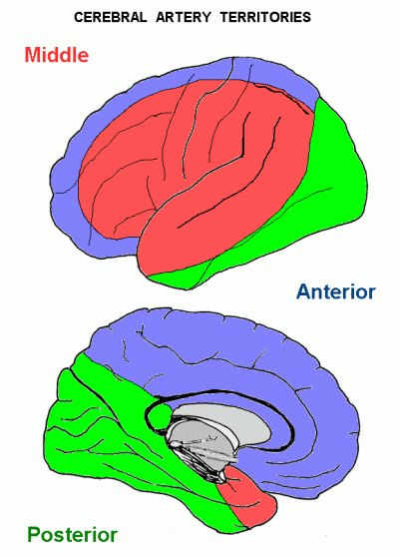
Arterial territories
http://instruct.uwo.ca/anatomy/530/530notes.htm
Notes:
(D) B to show penetration of arteries

Slide 9
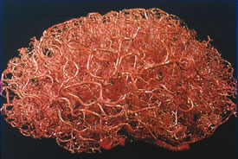
Blood vessels are extensive

Slide 10
Vascular Dementia (VD)
A decline in cog fxg skills caused by conditions that block or reduce blood flow to the brain, including:
Stroke
Diabetes
High blood pressure
High cholesterol
Anoxia (due to surgery, injury, etc)
Many prefer the term "vascular cognitive impairment (VCI)" to "vascular dementia" because it better expresses the continuum of cog changes that can occur
Vascular compromise causes up to 30% of all dementias
Symptoms depend on etiology:
Stroke sx may include = confusion, trouble speaking or understanding speech, vision loss, motor paralysis/weakness
VD due to chronic diseases (DM, HTN, high cholesterol) often present with motoric and cognitive slowing, difficulty recalling info (improved with cueing), intact orientation (or improved with cueing)

Slide 11
VD Management Strategies
Vascular prophylaxis to reduce impact of further damage
If stroke, medical workup to determine etiology and correct for it
Improve management of chronic vascular conditions (med compliance, attend appts)
Improve diet and exercise under direction of medical professional if applicable to underlying vascular condition
Memory medication
Cog strategies: encode info with verbal and visual cues, link info, allow extra time, don’t multitask
Serial cog evals to track (should not see much progression unless mixed dementia or further evolution of underlying vascular condition)

Slide 12
Stroke
Third leading cause of death, and leading cause of serious, long-term disability
Risk increases with age (60+); 585,000 older adults dx’d w/stroke per year makes new dxs higher than new AD dxs (~450,000/year).
Interruption of blood flow
Symptoms are focal, and reflective of the area of the brain that has been damaged by the stroke and secondary swelling (most occur in MCA)
Ischemic strokes (blockages) = 88% of all strokes; hemorrhagic = 12% (80% of these are fatal)
Duration of blood vessel occlusion is related to severity of deficits
Notes:
75% of the 780,000 strokes per year (585,000) happen in the elderly (65+), and stroke risk doubles every year after age 55!
Hemorrhagic strokes are caused by the rupture of a blood vessel in the brain that allows blood to leak inside the brain. The initial rupture may relate not only to weakness in the vessel wall itself, but to softening of the brain tissue surrounding the vessel. The vessel and/or tissue abnormalities leading to hemorrhage can be caused by aneurysms, angiomas (congenital collections of abnormal vessels including capillaries, veins and arteries such as arterial venous malformations), blood diseases such as leukemia, infections, toxic chemicals, trauma, and brain tumors. An aneurysm is a small, irregular area of swelling in an artery wall that weakens and bursts over time, and is typically caused by hypertension, arterosclerosis, infection, or embolism. It is often accompanied by a headache, though there is a wide range of variability in the type and duration of headaches. For example, although 90% of headaches resulting from aneurysms are often sudden and intense (“the worst headache of my life”), and accompanied by neck stiffness (“Kernig’s sign”), nausea, and pain in the occipital region, headaches may also be chronic over many years if the aneurysm is slow to develop and exerts pressure on the dura over time. Aneurysms account for 50% of all strokes in people under age 45. The most common site for hemorrhage is in the basal ganglia, and the most common cause is hypertension.
After 30 seconds of oxygen deprivation, ischemia may develop. After one minute of oxygen deprivation, neuronal function may cease, and after 2-5 minutes, infarcts (areas of dead or dying tissue) may develop. The hippocampus is especially sensitive to hypoperfusion, and hippocampal sclerosis may result from oxygen deprivation.

Slide 13
Differentiating Stroke from Dementia
Onset of cognitive deficits is sudden (vs. gradual and insidious), and often accompanied by neighborhood motor or speech abnormalities (depending on localization of the stroke)
Cognitive deficits (per neuropsychological testing) are more specific and “patchy” (vs. dementia in which memory is typically impaired in a more “global” fashion, along with other cognitive skills)

Slide 14
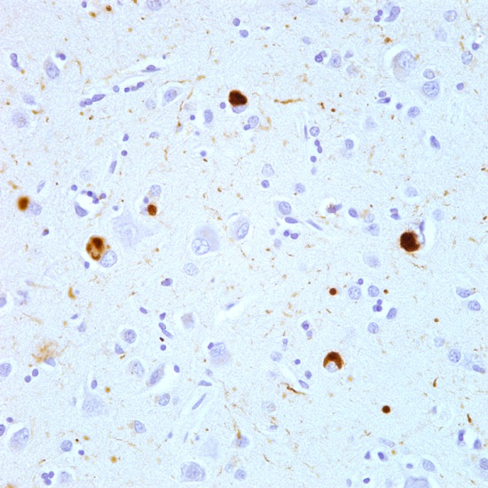
Lewy Body Dementia (LBD)
Named for abnormal protein deposits within neurons (alpha-synuclein)
Alpha-synuclein = abundant in normal brain; unfolded
“Lewy Body” = abnormal folding, located WITHIN the neurons
Notes:
Protein is alpha-synuclein and forms inside neurons; it is found abundantly in the normal brain (unfolded), and helps to ensure supply of synaptic vesicles, and may be involved in motor activity; it becomes a “Lewy Body” when its constituents are abnormally folded and found in intracellular areas
LBD is one of multiple synucleopathies, including Parkinson’s and Multiple Systems Atrophy
“Lewy bodies” can be found secondarily in Alzheimer’s as well, and may be located in cortical and subcortical areas
Other notes (if questions):
Controversy over whether LBD, PD with dementia, and AD with lewy bodies are a separate entity; some suggest it is on a continuum;
Although severity of dementia is associated with LBD cortical burden, some cases of PD with dementia lack cortical pathology and some patients at autopsy with PD and lewy bodies don’t have dementia

Slide 15
α-Synucleinopathies
The LOCATION and type of cell impacted by α-synucleinopathy leads to different symptoms
Primary α-Synucleinopathies
Parkinson’s
LBD
Multiple Systems Atrophy
Secondary α-Synucleinopathies
AD
Notes:
1. PD is the most prevalent of the α-synucleinopathies and much of the initial research on α-synuclein Lewy body pathology was based on PD
In PD, α-synucleinopathy is located in substania nigra (movement area of brain), and as such is a DOMINANT MOVEMENT DISORDER, with two of four cardinal signs (bradykinesia, rigidity, resting tremor, gait instability) that are responsive to levodopa therapy
2. LBD is a DOMINANT COGNITIVE DISORDER, with the α-synucleinopathies typically located in the limbic system (emotional center of brain) and association cortex (the areas on the surface of the brain that bring together
3. Multiple system atrophy is unique in that α-synuclein deposition occurs in oligodendrocytes (which form myelin in the CNS - like Schwann cells in the Peripheral NS) rather than neurons.
4. α-synuclein deposition can also occur secondarily in AD (in as many as 50%; Lewy bodies are often in amygdala)

Slide 16
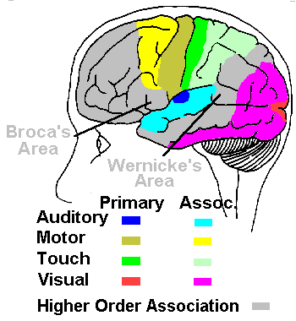
Association Cortex

Slide 17
Diagnosing Lewy Body Dementia
Consensus criteria include:
Presence of dementia (gradual onset, progressive course)
At least two of the following
Parkinsonism
Visual hallucinations
Fluctuations in consciousness (“switch-like”)
LBD = 10-30% of all dementias (2nd or 3rd most common after Alzheimer’s, possibly vascular); 1.3 million Americans
Notes:
Sx of Parkinsonsim = extrapyramidal signs including bradykinesia (slowed movement), masked facies, gait abnormality, and myoclonus (sudden jerking), but not usually extreme rigidity, resting tremor
25% of pts w/LBD start with Parkinsonian sx, and 25% never develop them
VH: = well-formed, often people and animals, may include portions of objects, may be lilliputian; person may have intact reality testing; may interact w/hallucinations

Slide 18
LBD symptom pattern
Parkinsonism
VH
6
18
13
35
7
18
2
Fluctuations
Notes:
Some characterize LBD and PD along a continuum, and define LBD as presenting first with cog impairment, and PD presenting first with motor impairment

Slide 19
Lewy Body Dementia – Secondary symptoms
Other clinical features may also be supportive of diagnosis
Hallucinations in other modalities
Repeated falls
General visual problems, illusions
Syncope
Delusions
Increased sensitivity to classic antipsychotic medication
REM sleep disturbance (occurs in 72%)
Notes:
REM Sleep Behavior Disorder (RBD) is often noted in persons with Lewy Body Dementia. During periods of REM sleep, the person will move, gesture and/or speak. There may be more pronounced confusion between the dream and waking reality when the person awakens. RBD may actually be the earliest symptom of LBD in some patients, and is now considered a significant risk factor for developing LBD. (One recent study found that nearly two-thirds of patients diagnosed with RBD developed degenerative brain diseases, including Lewy body dementia, Parkinson’s disease, and multiple system atrophy, after an average of 11 years of receiving an RBD diagnosis)

Slide 20
Hallucinations
Vivid, colorful, complex
Case examples
Often people and animals
May be free-standing or embedded in a visual scene
May occur more around awakening, sleep
May be miniature/Lilliputian
Often involve delusions bc person trying to make sense of what they are seeing
Person may attempt to interact with them
Possibly linked to Lewy Bodies in the right temporal lobe

Slide 21
Assessing Visual Hallucinations
Management recommendations differ depending on assessment findings
What is the content of the hallucination, and how frequently does it occur?
Is there any pattern to the occurrence (time of day, specific room, etc)?
Is the person bothered by the hallucinations?
Does the person have intact reality testing?

Slide 22
Tools to treat Visual Hallucinations – Part 1
Medication
Acetylcholinesterase inhibitors (memory medication) may be helpful
Other meds may include anxiety medication for use if there is distress
Antipsychotic meds are rarely used
Antidepressants may help with mood symptoms; clonazepam can help with REM sleep disorder
Notes:
ANTIPSYCHOTIC MEDICATION = rarely used bc of possible serious side effects in up to 50% of pts, including swallowing problems, confusion, hallucinations and delusions, increased PD symptoms; IF PERSON NOT BOTHERED BY VH, THEN MEDS FOR THE HALLUCATIONS MAY NOT BE NECESSARY.

Slide 23
Tools to treat Visual Hallucinations – Part 2
Education
Pt education depends on reality testing
If intact = movie analogy
If not intact = distraction, “balanced validation,” manage any distress
Family education about the reason for visual hallucinations
Other tools
Ensure corrected vision
Experiment with more light vs. no light; night lights
Notes:
Intact reality testing = Explain that their brain is creating images “that other people don’t see”, kind of like images in a movie; some people “learn to ignore” them; camera technique
for family about how they are providing treatment by responding therapeutically (explain the reason for hallucinations, make analogy that the image is as real as the caregiver experiences when looking at something; encourage not to challenge content, provide emotional support and “balanced validation”)

Slide 24
Treatment for cognitive symptoms
Memory medication
Rivastigmine (Exelon) has greatest evidence base
Consider avoiding nighttime doses if increase in vivid dreams (possible medication side effect)
Memantine (Namenda) shown helpful in 1 of 4 studies

Slide 25
Treatment for psychiatric symptoms
Anxiety and depression may predate cognitive and motor symptoms by decades
Depression
May be helped by Exelon
SSRIs = mixed results
Electroconvulsive therapy and transcranial magnetic stimulation have been shown effective, but are rarely used
Anxiety
Anxiolytic medication may help

Slide 26
Treatment for motor symptoms
Physical therapy
Home safety modification (especially fall prevention)
Medications used in PD (e.g. Levodopa/Carbidopa) are usually less effective in LBD, and could increase neuropsychiatric symptoms, but can be used

Slide 27
Treatment of sleep problems
REM Sleep Disorder
Behavioral strategies
Melatonin
Clonazepam
Excessive daytime sleepiness
Decrease sedating meds
Rule out primary sleep disorders
Caffeine
Mixed evidence for Ritalin

Slide 28
Frontotemporal Dementia

Slide 29
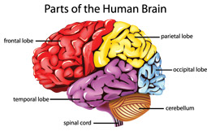
Frontotemporal Dementia (FTD)
Dementia that begins in the frontal lobe, temporal lobe, or both
Notes:
The location where the changes start – either neuronal loss or protein abnormalities – determines the types of behavioral and cognitive changes that are initially seen, and helps to understand the subtype of the dementia
Onset is usually in the 50’s and 60’s with average age of onset at age 57, which is significantly younger than most other types of dementia, usually leading to problems with work and family

Slide 30
FTD Overview
Progressive decline in behavior and personality and/or language, resulting in significant impairment in social and daily activities, and increasing dependence on caregivers
FTD is the cause of 10-20% of all dementias
As common as Alzheimer’s dementia in individuals <65 years old (average age of onset is 57)
Life expectancy = 7-13 years (ranges from 2-20)
Causes: Unknown in most cases, though some studies show abnormal protein deposits and genetic risk factors
Often initially misdiagnosed
No treatments to slow or stop progression, but some treatments help to manage symptoms; clinical trials are underway
(http://www.theaftd.org/frontotemporal-degeneration/ftd-fast-facts)

Slide 31
Three subtypes of initial symptoms in FTD
Progressive behavior/personality change: changes in personality, judgment, behavior, emotions
Progressive language decline: changes in speaking, comprehending, reading, and writing
Progressive motor decline – difficulties with physical movement such as shaking, difficulty walking, frequent falls, poor coordination

Slide 32
Types of FTD
Progressive behavior/personality decline
Behavioral variant FTD (bvFTD)
Temporal/frontal variant FTD (tvFTD, fvFTD)
Pick’s disease
Progressive language decline
Primary progressive aphasia
Progressive motor decline
Corticobasal syndrome (CBS)
Progressive supranuclear palsy (PSP)
FTD with parkinsonism
FTD with amyotrophic lateral sclerosis (FTD-ALS)
Notes:
CBS – muscle rigidity, difficulty closing buttons, language and spatial orientation problems

Slide 33
Behavioral Variant FTD (BvFTD)
The most common FTD
Involves changes in behavior, personality, judgment
Behavioral manifestations
Unusual behavior that is out of context for the social situation
Person usually does not know or care that behavior is unusual (loss of insight)
Reduced empathy for the feelings of others, likely due to impaired ability to recognize facial or vocal emotions
Hyperorality (excessive eating, often of sweet foods)
Disinhibition
Impulsivity
Lack of initiation
Social withdrawal
Cognitive domains impacted: executive functioning/EF (planning, mental flexibility, speeded strategic tasks including verbal and nonverbal fluency); memory initially stronger than EF

Slide 34
3 Subtypes of Language – related FTD/Primary Progressive Aphasia (PPA)
Logopenic PPA– Changes in the ability to use language to communicate with others through speaking, reading, writing, and comprehending what others are saying. Symptoms often include problems with word finding, and hesitations/pauses while speaking
Agrammatic PPA (Progressive nonfluent aphasia) – omitting words that link nouns and verbs (such as to, from, the); difficulty swallowing
Semantic PPA (semantic dementia) – difficulty understanding words or recognizing familiar objects and people

Slide 35
FTD Management Strategies
Get an accurate diagnosis
Establish a daily routine
Address any safety issues
Attempt to manage symptoms with behavioral interventions if possible
Medications may be helpful with depression or delusions
Caution: some memory meds (acetylcholinesterase inhibitors) can worsen symptoms
Encourage pt to connect with agencies (Alz Assn, The Association for Frontotemporal Dementias) for education, access to resources, and support
Notes:
Accurate diagnosis – some treatments for AD, for example, are contraindicated in some types of FTD
Behavioral interventions: breaking tasks down, multiple choices or “Let’s do this..” rather than “don’t do…”; use environment itself to act as a prompt for behavior; often need to use a cue to begin or “go” to combat difficulty with initiation; use alternative communication devices if PPA; redirect disinhibited behavior; if utilization behavior (pt using or exploring ethg in env), enrich env with picture books or activities they enjoy (model making, knitting); if person enjoys repetitive activities, fill env with those (jigsaws, word search puzzles); if in public, position person to limit contact with public and minimize triggers; a daily walk or other behavioral routine can combat apathy; remain positive (since frustration may be responded to); only provide as much help as necessary, and do tasks together if possible (rather than doing for the person); sometimes just telling the person what step to do next can help (you are acting as the planner and “executor” or frontal lobe)
Support agencies – crucial for family members to understand how different family relationships are differentially impacted

Slide 36
FTD Resources and Support
The Association for Frontotemporal Dementias http://www.theaftd.org/frontotemporal-degeneration/disorders
Alzheimer’s Association: http://www.alz.org/dementia/fronto-temporal-dementia-
Frontotemporal Dementia Caregiver Support Center http://ftdsupport.com/

