Slide 1

2013 County Budget

Slide 2
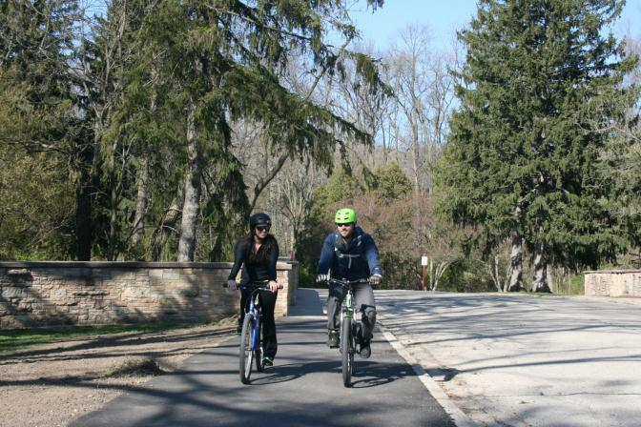
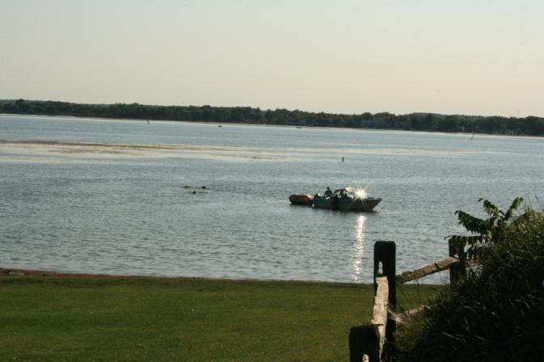
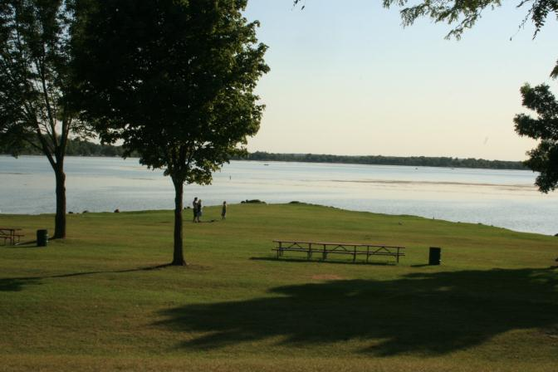
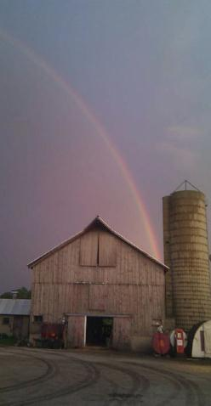
Kenosha County:
A great place to live

Slide 3
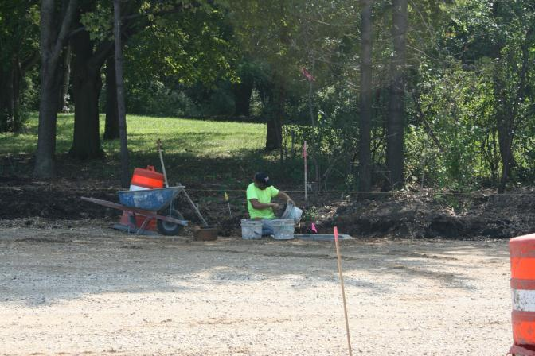
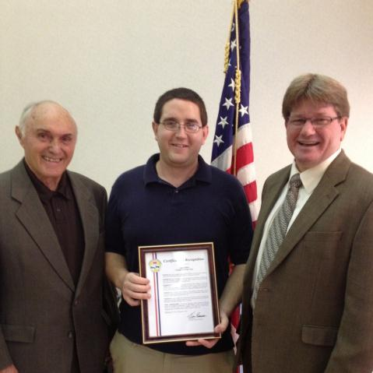
Kenosha County:
A great place to work

Slide 4
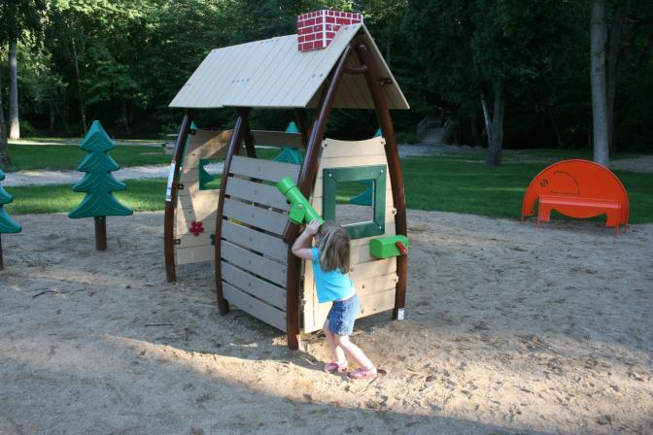
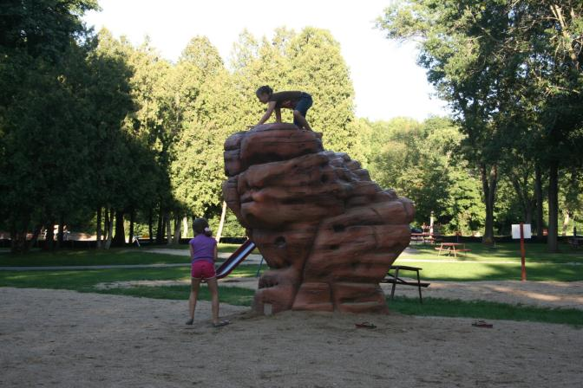
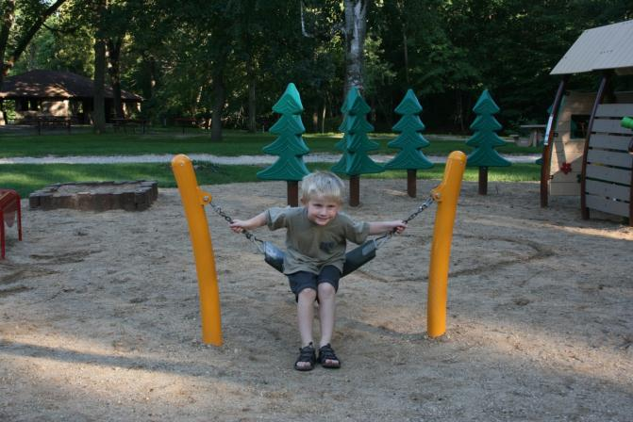
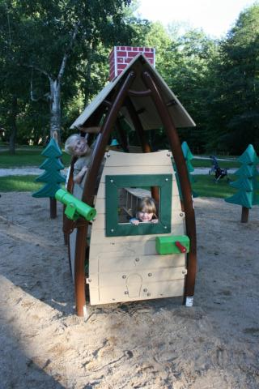
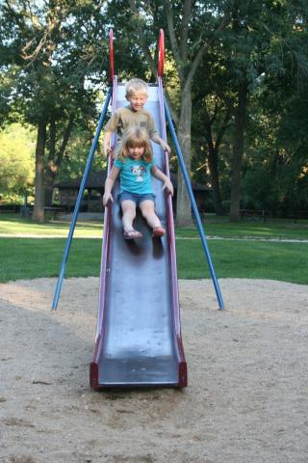
Kenosha County:
A great place to raise a family

Slide 5
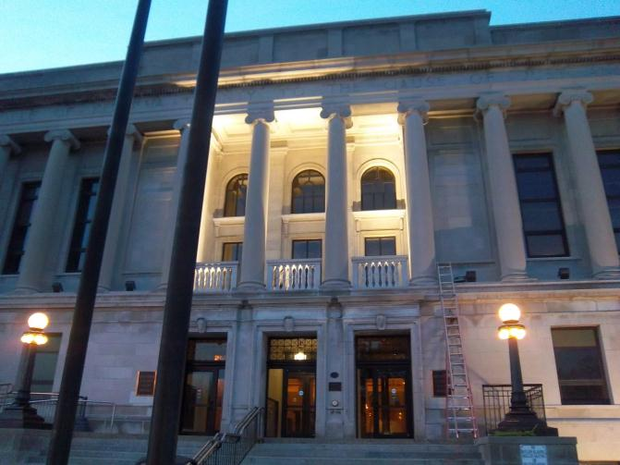
Kenosha County Courthouse

Slide 6

Our New Website

Slide 7
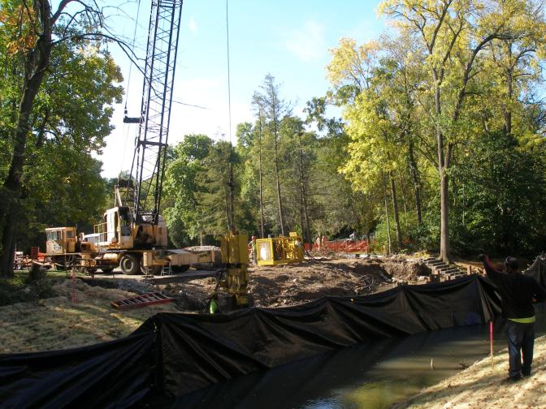
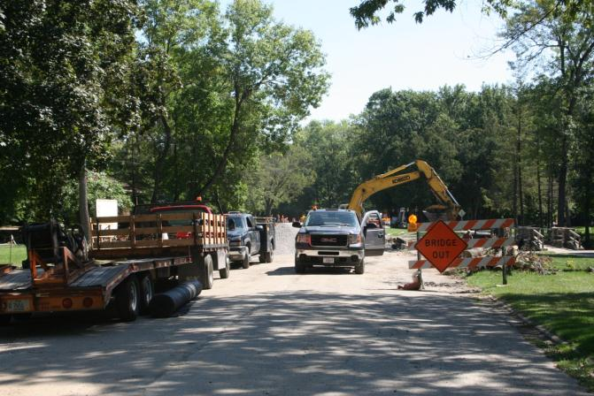
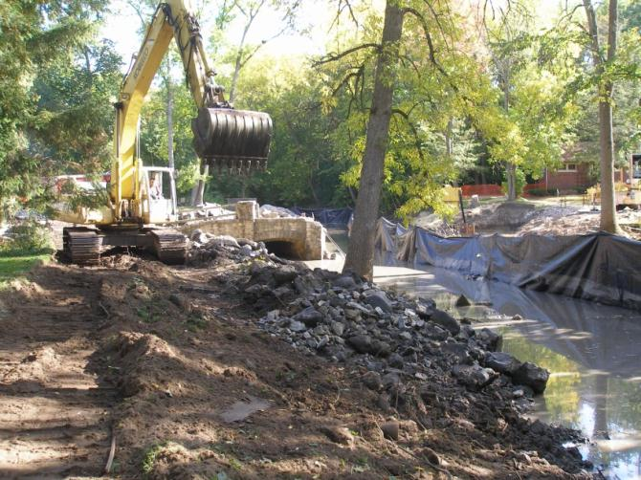
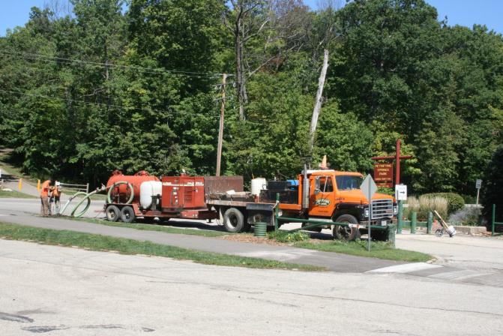
Petrifying Springs

Slide 8
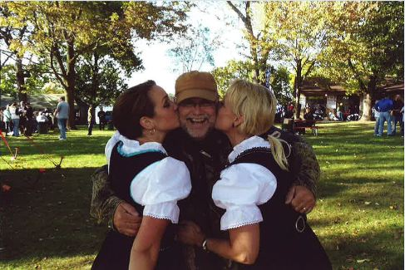
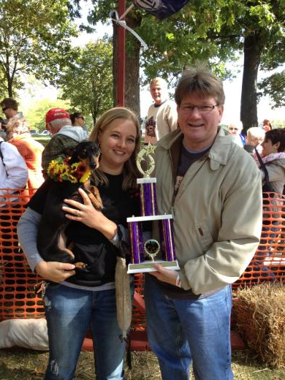
Oktoberfest

Slide 9
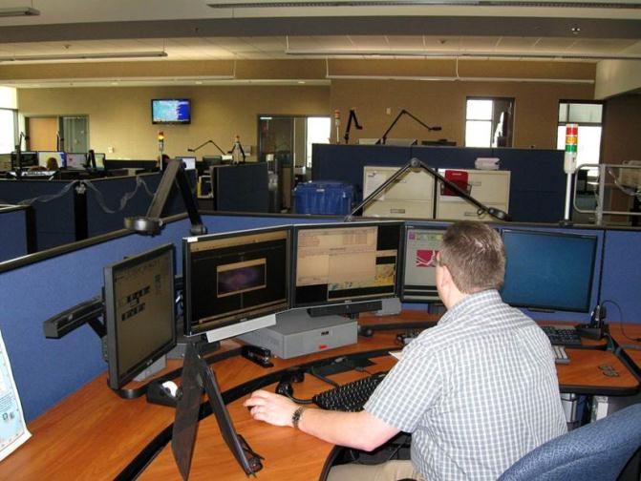

Joint Services

Slide 10
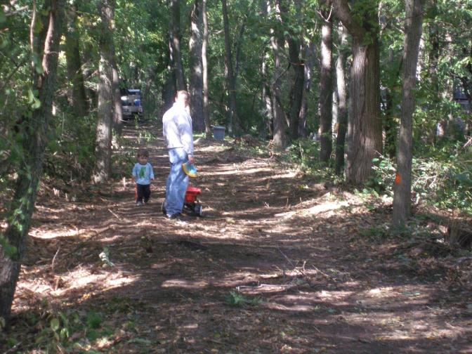
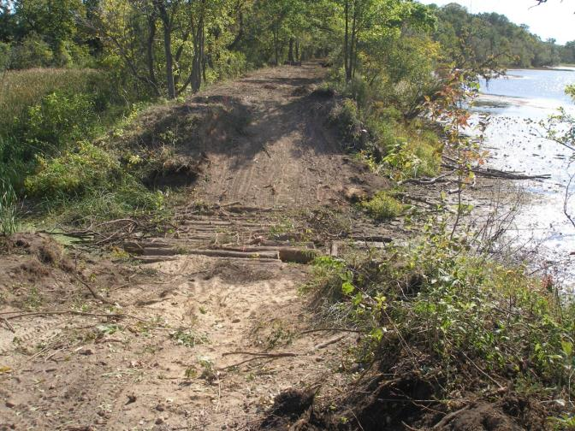
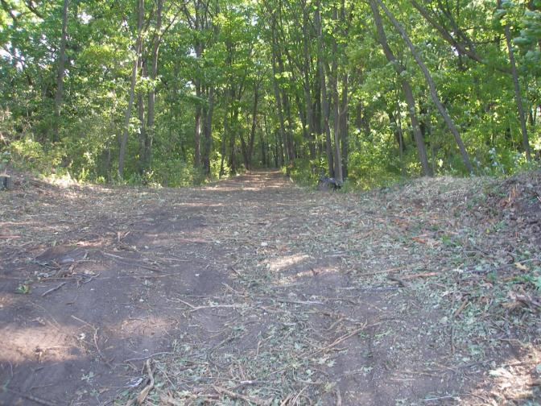
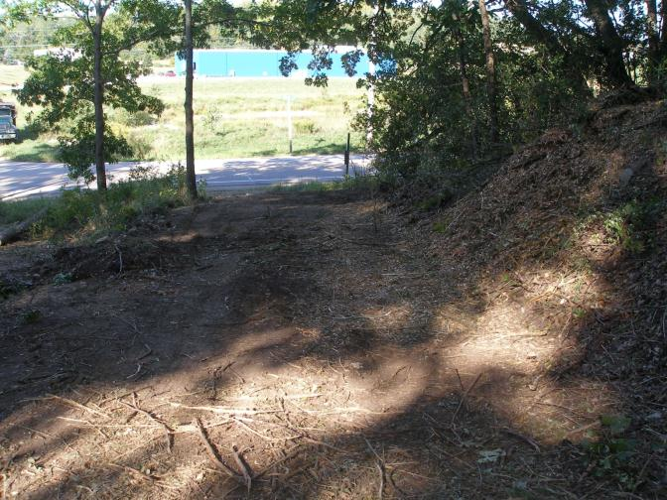
Silver Lake Icehouse Trail

Slide 11


High Speed Broadband
Residential
Corporate
Public Safety

Slide 12
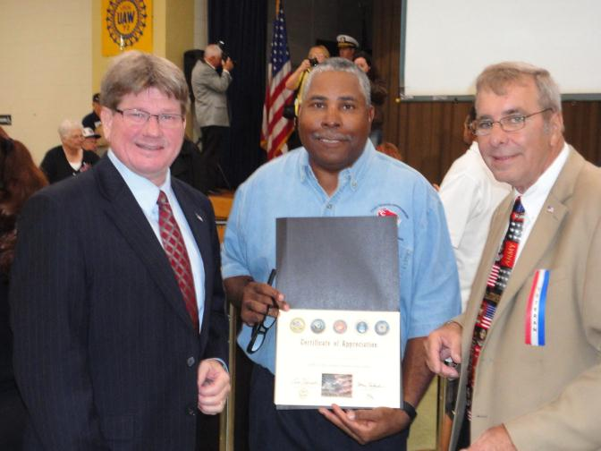
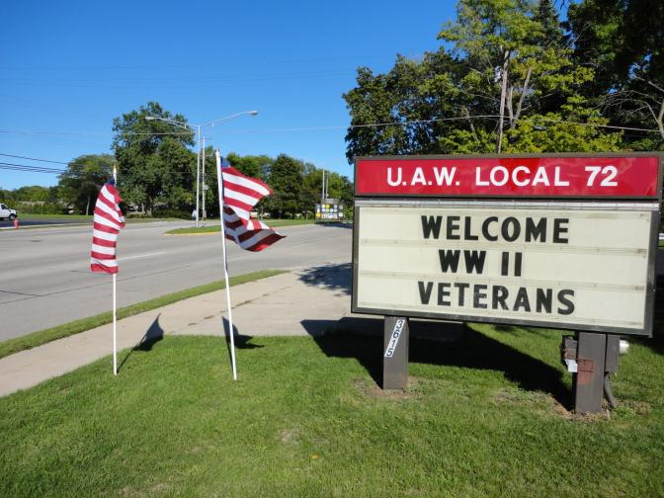
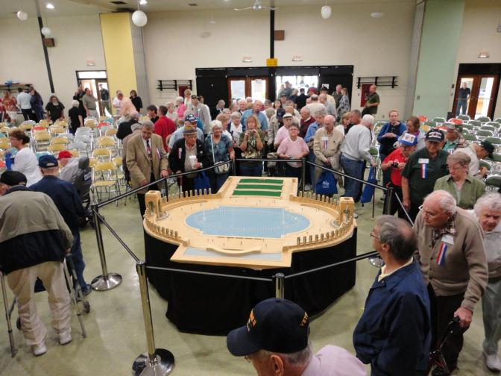
Pillars of Honor

Slide 13

Future Important Dates
November 6 Election
February 2013, Gov. Scott Walker presents State Budget
June 2013, State Biennial Budget slated for approval

Slide 14

State/Federal Funding vs. Levy

Slide 15
County Tax Levy Decline

Slide 16
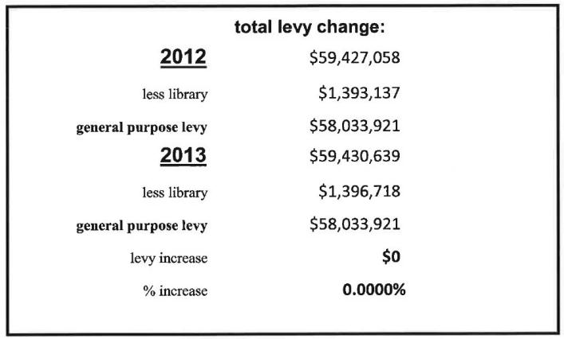
Tax Levy Change

Slide 17
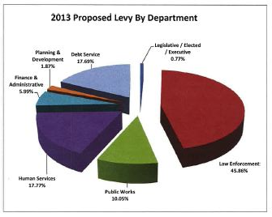
Tax Levy by Department

Slide 18
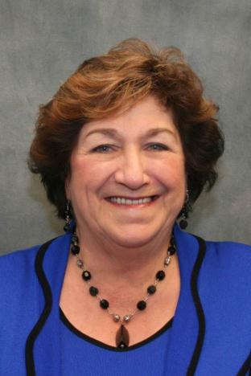
Louise Principe
Thank you for your service, Louise!

Slide 19
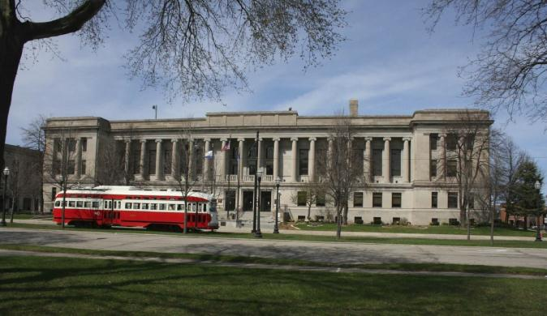
Taxpayers will see a modest decrease in their tax bill for county purposes

Slide 20
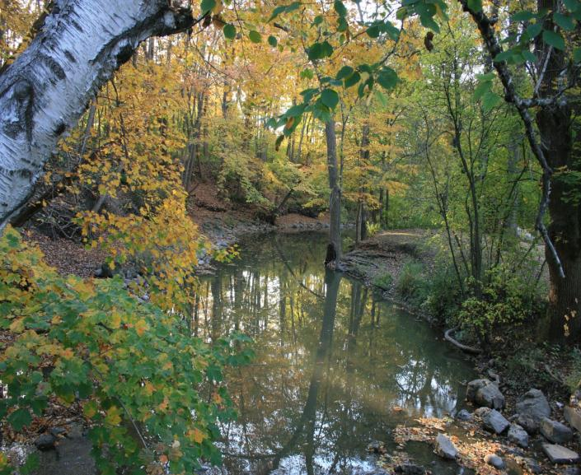

Slide 21

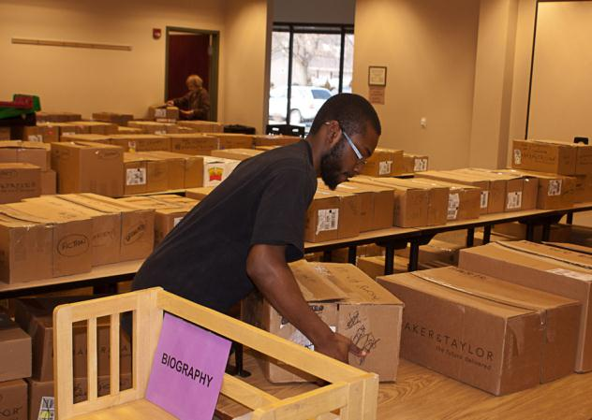
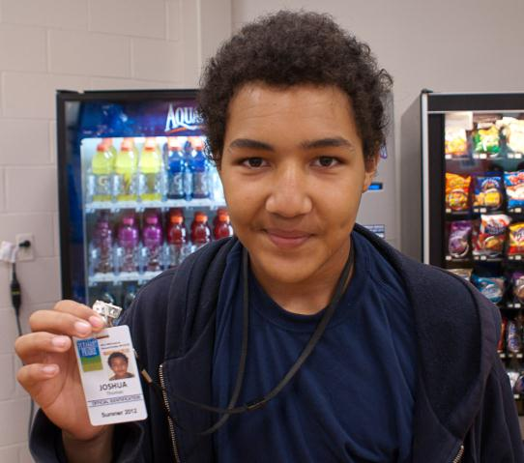
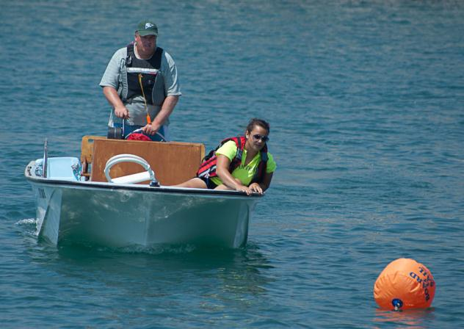
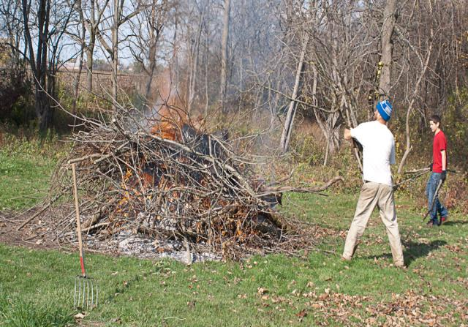
Summer Youth Employment Program

Slide 22
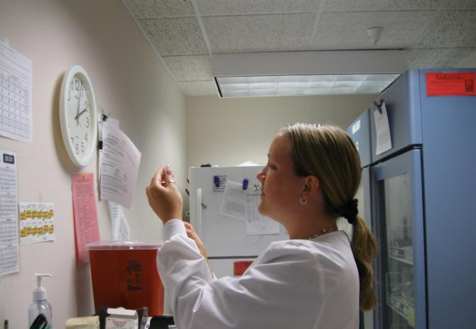
Health Department

Slide 23

Golf Courses

Slide 24
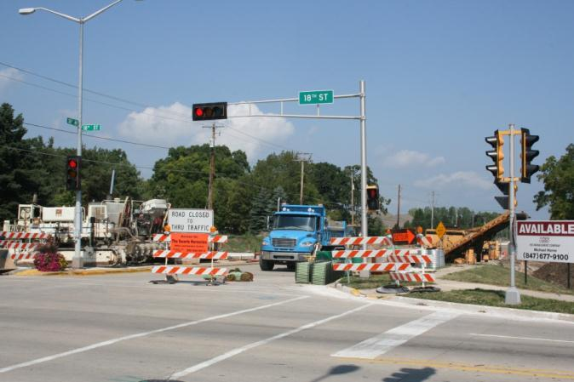
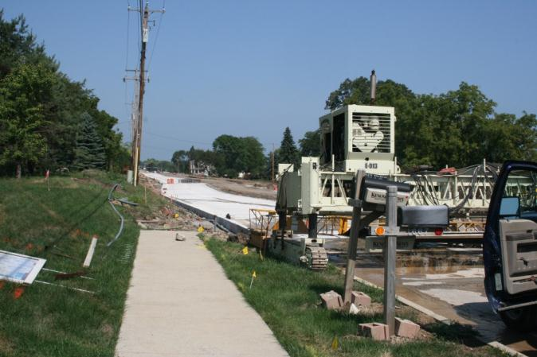
Highway G Road Construction

Slide 25
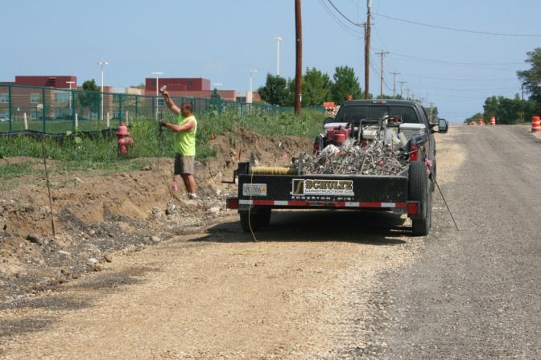
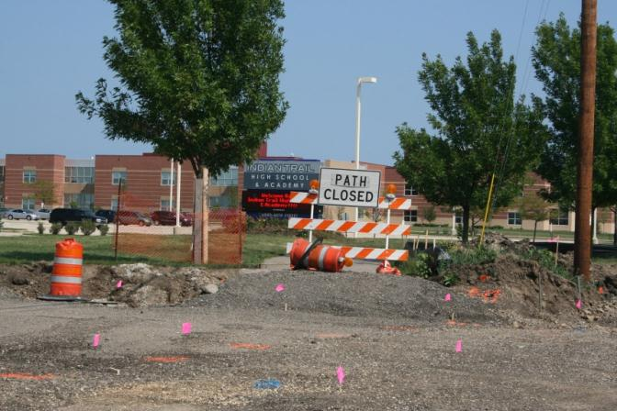
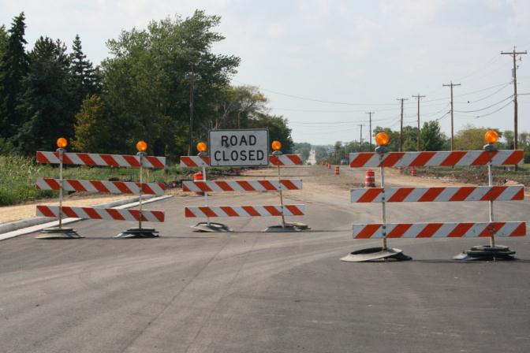
Highway K Road Construction

Slide 26


Slide 27
Health Plan Changes
Effective January 1, 2013:
Five percent (5%) annual contribution of the budgeted rate
Wellness incentive program – Allowing employees to reduce annual contribution through healthy lifestyle initiatives
Dental coverage offered at employee’s expense
Vision program offered at employees expense
Eliminate the following covered services:
  Coverage for morbid obesity
  Private Duty Nursing
  Limited coverage for ambulance and time in a skilled nursing facility
All employees, not under contract, enrolled in “H” plan at 21% employee contribution
Total employee contribution = 32%

Slide 28
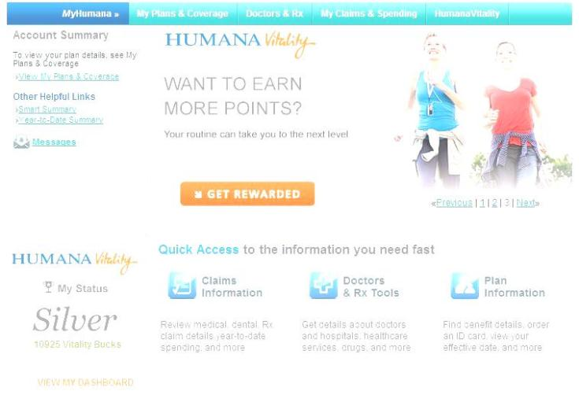
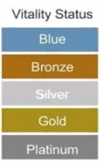
Humana Vitality
5
4
3
2
1

Slide 29
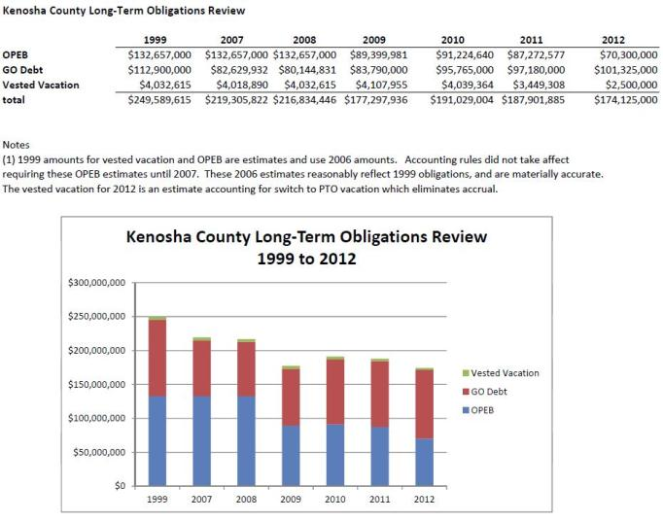
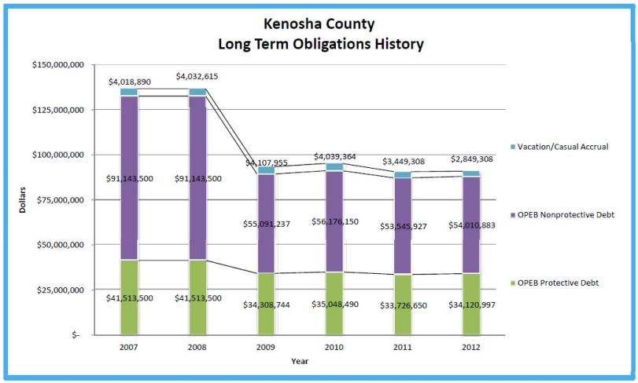
OPEB Update

Slide 30
Tax Levy Change

Slide 31

Our Biggest Challenges
  To keep our vision of the great things that are happening and can happen in Kenosha County, while
  Meeting our fiscal responsibilities head-on
  Without getting hung up by the naysayers or getting distracted by the minutia.

Slide 32

God Bless Kenosha County

