Slide 1
2015 County budget presentation
October 7, 2014
County Executive Jim Kreuser

Slide 2
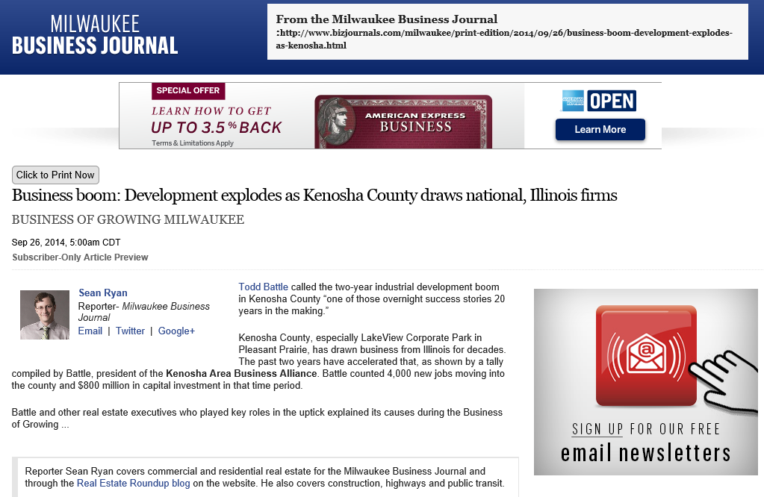
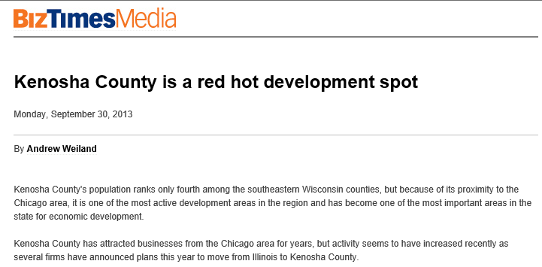
Kenosha County is a Development Hot Spot

Slide 3
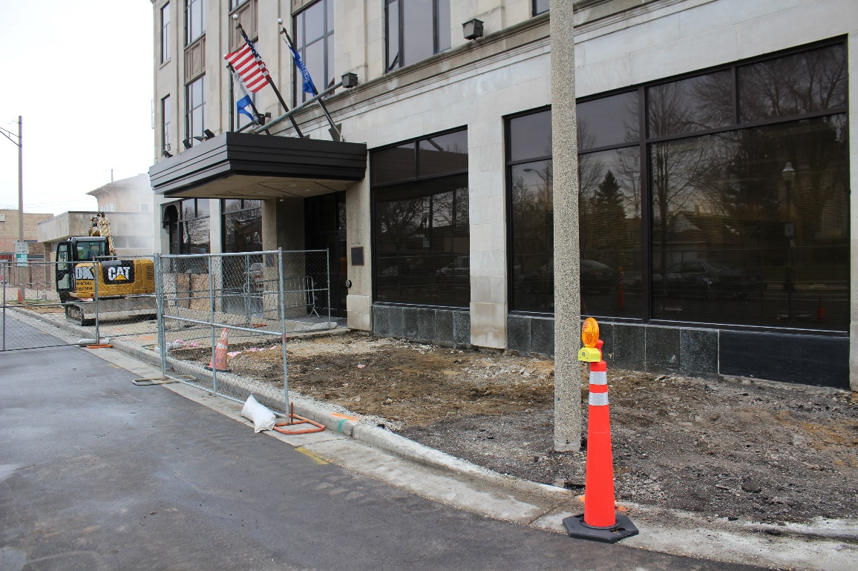
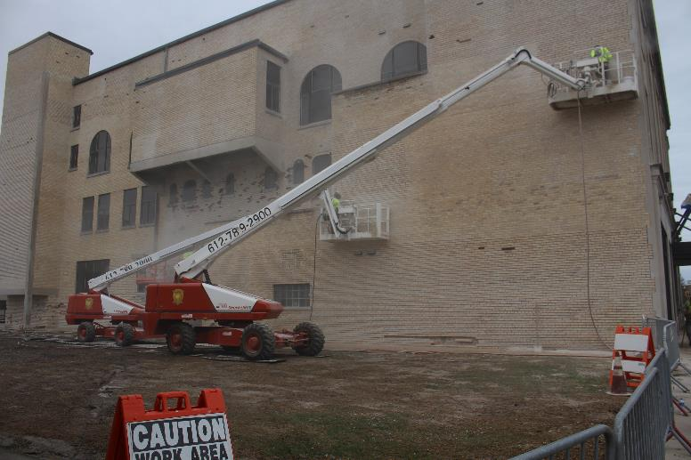
KCAB Restoration
4

Slide 4
5

Slide 6
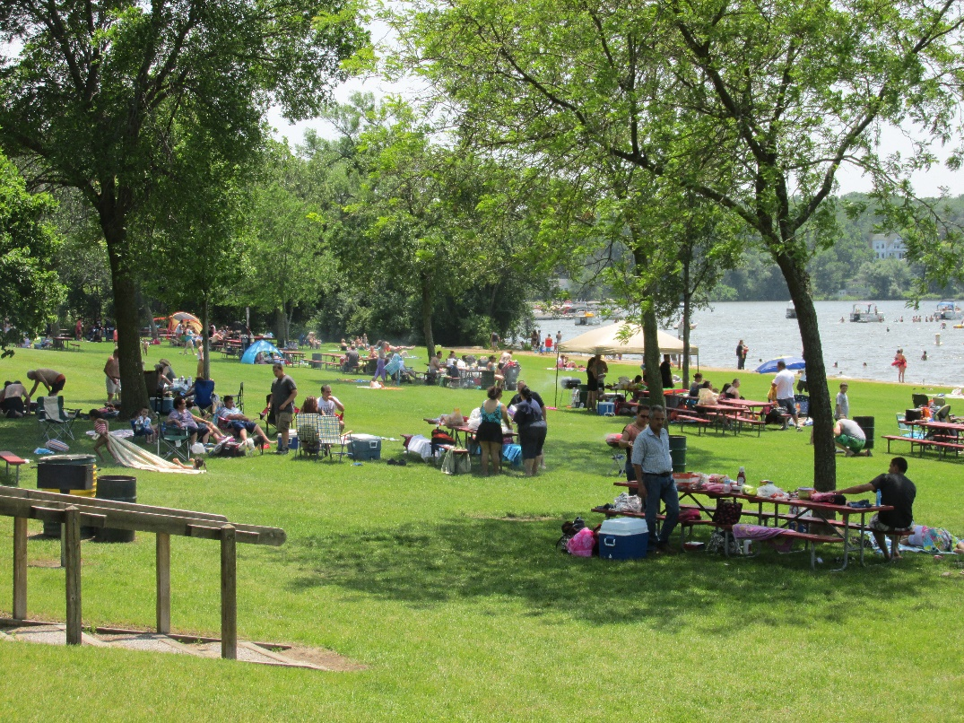

Slide 7
Key Factors Supporting Kenosha County Development Activity and Success
Improving National Economy
Wisconsin’s competitiveness relative to Illinois
Strategic Location Between 2 Major Midwest Metro Areas
Aggressive & Responsive Community & Economic Development Partners
Available, Development Ready Sites

Slide 8
Good Infrastructure Leads to Economic Development, which Leads to Jobs:

Slide 9
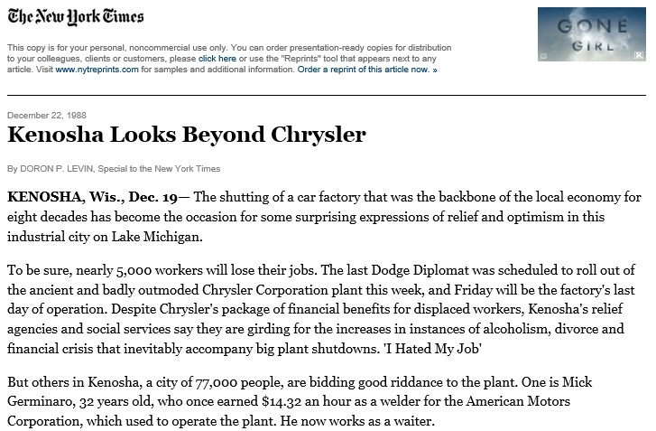
From Chrysler to WisPark

Slide 10
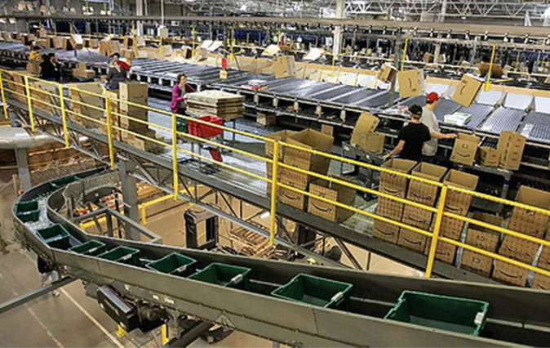
Amazon moves to Kenosha
Case Study: AMAZON.COM
Project: Two distribution centers - 1,000,000 SF & 500,000 SF on approximately 160 acres
Fortune 50 online retailer
Extensive & competitive site selection process
Development-ready site, proximity to I-94, location, and competitive incentive package drove decision

Slide 11
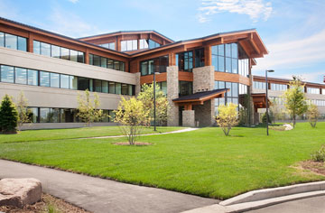
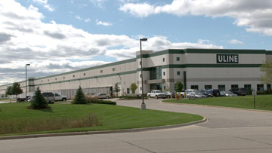
ULINE
Case Study: ULINE
Corporate HQs Expansion
Jobs: 500
Investment: est. $100 million
Project: 200,000 SF office building & 1,000,000 SF distribution facility
Midwest Distribution Operations in Kenosha
Jobs: 475
Investment: est. $75 million
Project: 1,000,000 SF distribution center with 60,000 SF of office

Slide 12
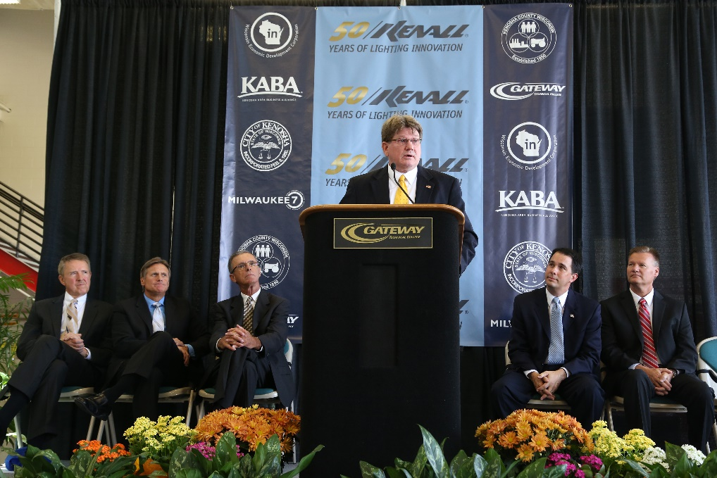

Slide 13
Public Works and Development Services

Slide 14
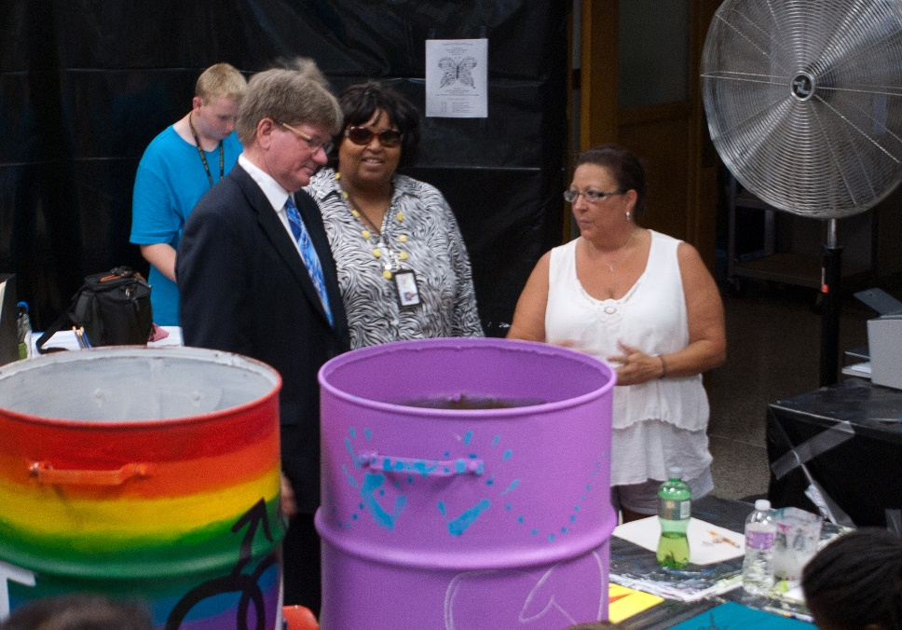
Safe community

Slide 15
Sheriff’s Department

Slide 16
Law Enforcement

Slide 17
Veterans Services

Slide 18
Serving our Community

Slide 19
Human Services

Slide 20
Other County Services

Slide 21
Tax Bill Comparison Chart

Slide 22
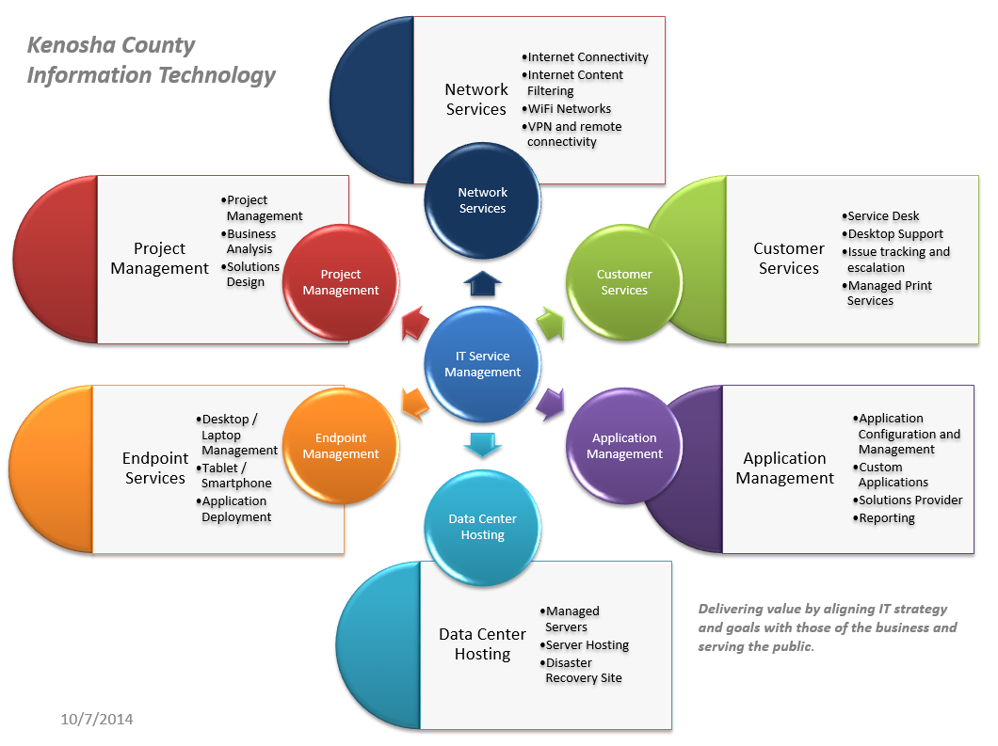

Slide 23
Protecting our Downtown Campus

Slide 24
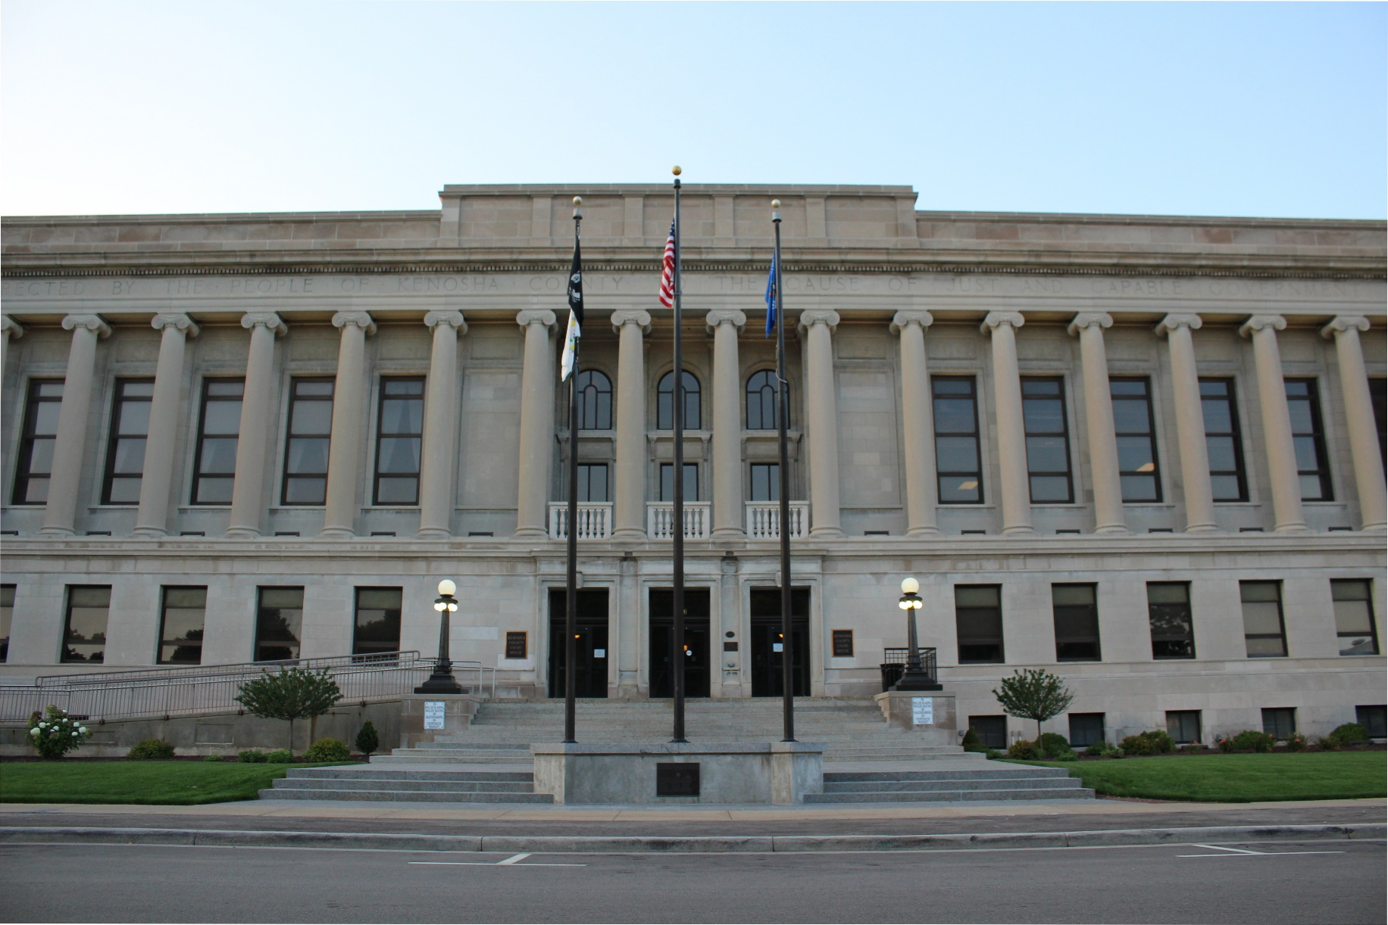
Planning for future space needs

Slide 25
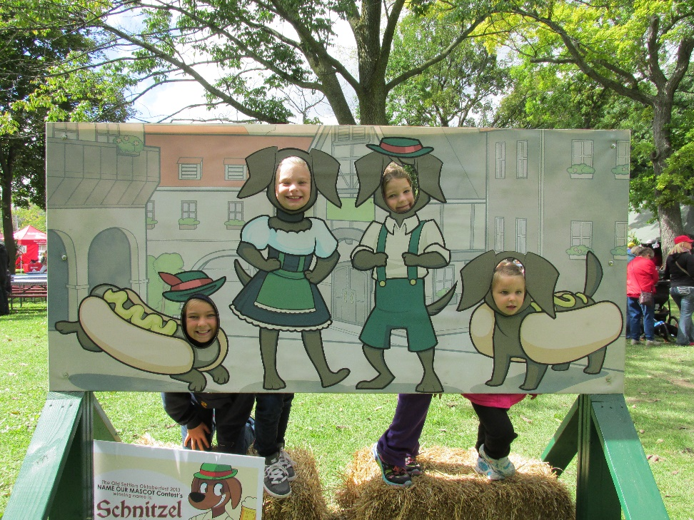

Slide 26
Mental Health Service Enhancements
Mental Health Services Proposal
$200,000 to increase Mental Health services in the jail to 80 hours a week
$81,500 to add a nurse practitioner or a Physician’s Assistant through a contracted service of Department of Aging and Disability Services. It would address the shortage of psychiatric services within Kenosha County, particularly the scarcity of psychiatrists who accept Medicaid patients. It will result in 750 to 1,000 additional clients to be served.

Slide 27
New Voting System

Slide 28
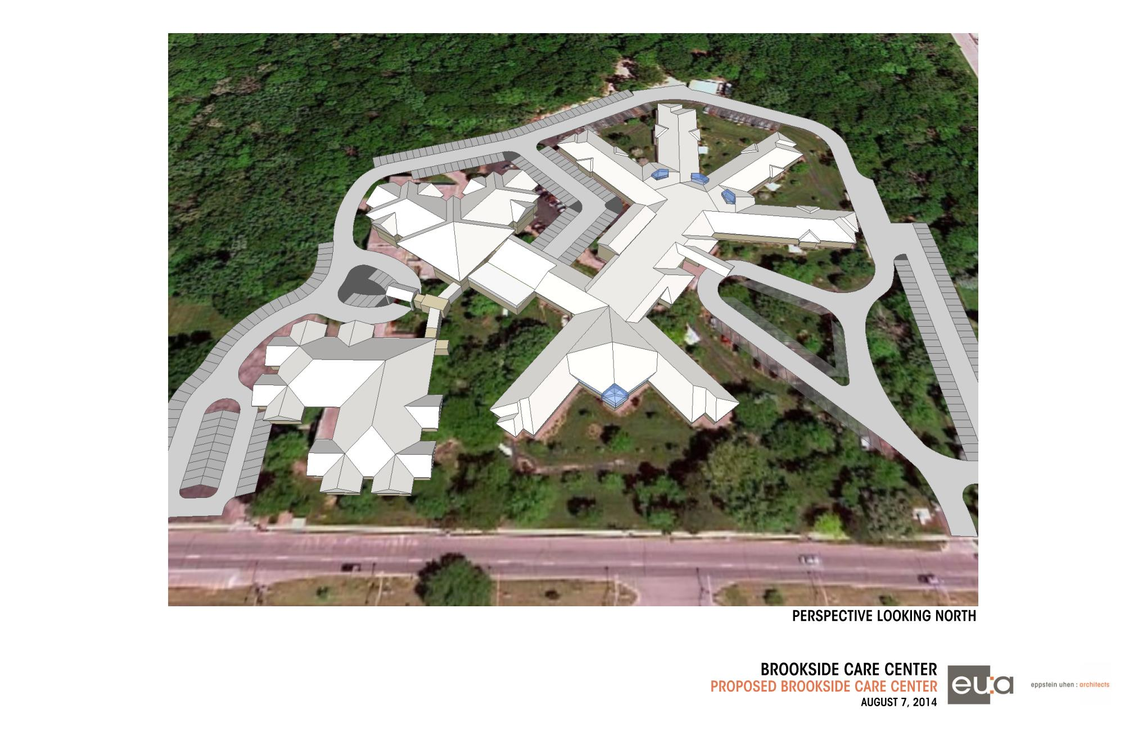
Brookside Care Center layout

Slide 29
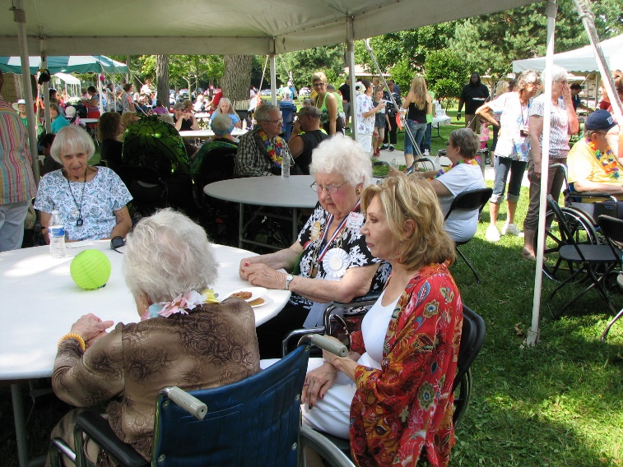
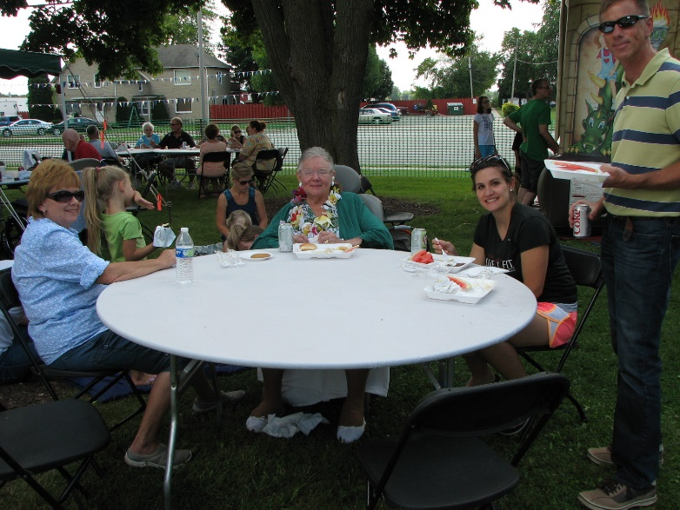
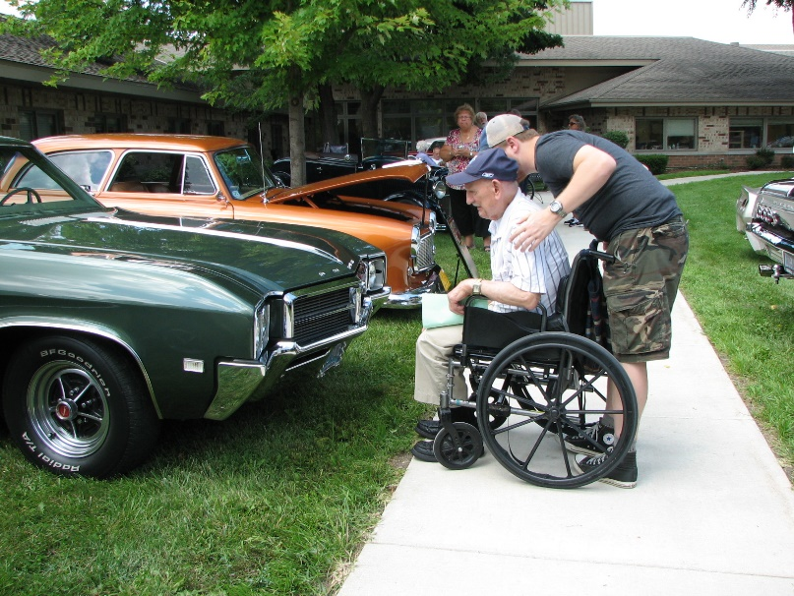
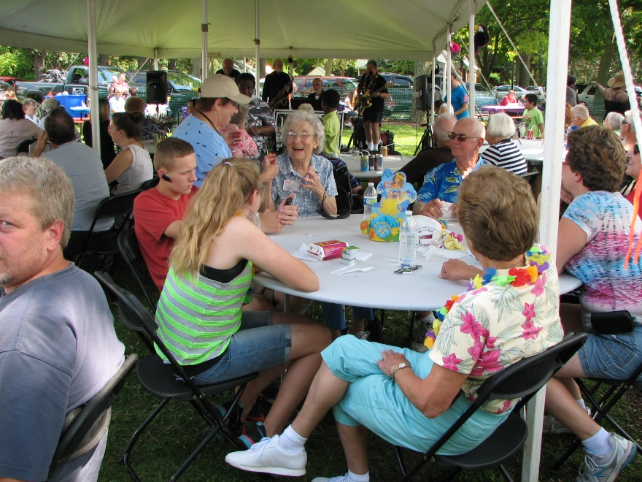
Brookside Picnic

Slide 30
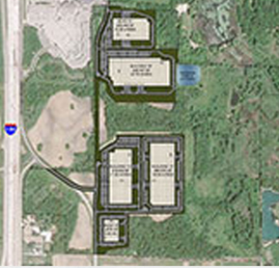
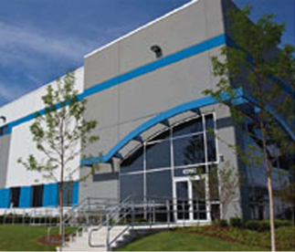
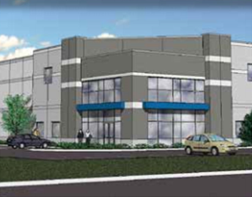
Building economic development opportunities
Influx of new business parks and speculative developments
RiverView Corp
Park
CenterPoint Properties’ Proposed LakeView Lots 117 & 118
Zilber’s Towne VI

Slide 31
Economic Development Summary
Several Major Industrial Developments have been announced in the past 18-20 months.
Major projects involving roughly 4,000 jobs, $800+ million of capital investment & 6.5 million SF of new development /absorption have been announced in that time period.
Unemployment rate has been cut in half in the last 4 years, falling from a peak of 12.9% (2/10) to 6.1% (5/14).
Steady improvement in business expansions, investment and hiring.
Industrial vacancy rate has dropped from double digits to 4.2%. 1.66 million SF was absorbed in 2013. New spec development(s) starting.
Economic Development prospect activity and project pipeline continues to be very strong.

Slide 33
God Bless Kenosha County

